Slide 1
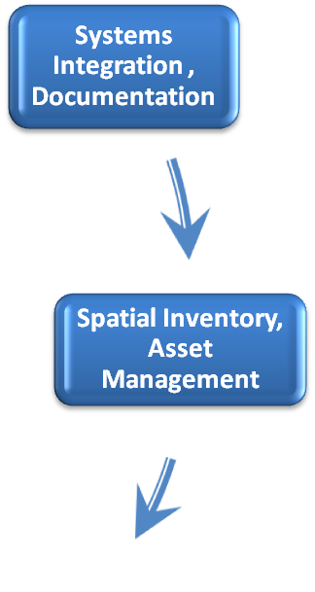
The ITS Process Cycle -
Spatial Assets
Spatial Data

Slide 2

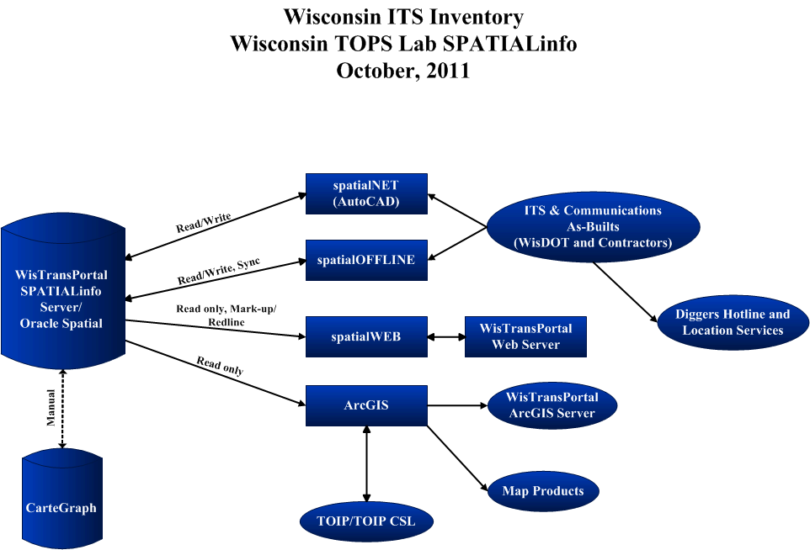
SpatialInfo Inventory System

Slide 3
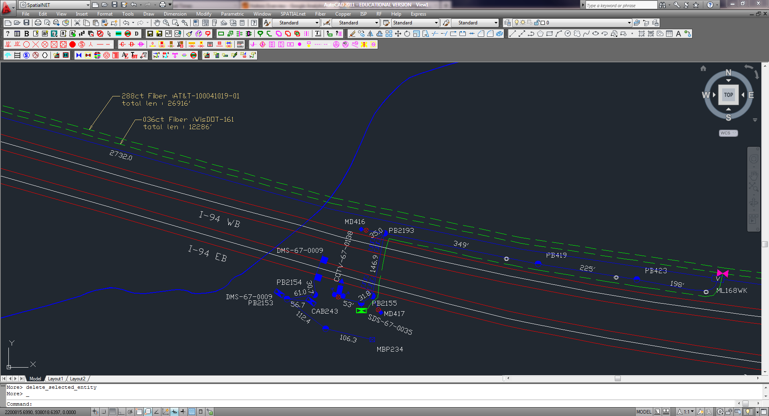
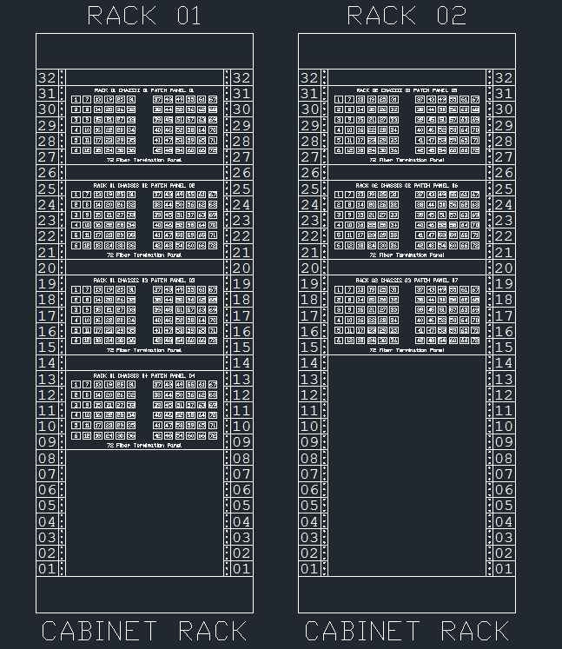
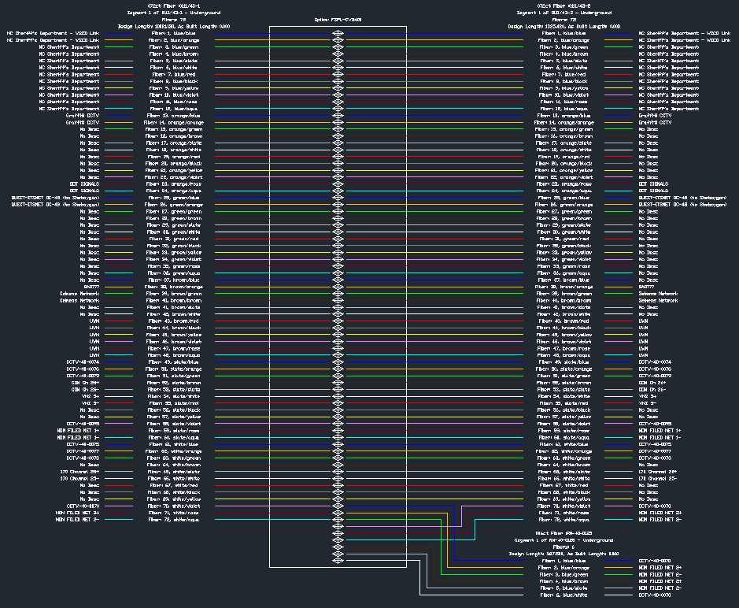

Slide 4
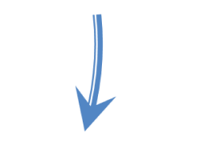
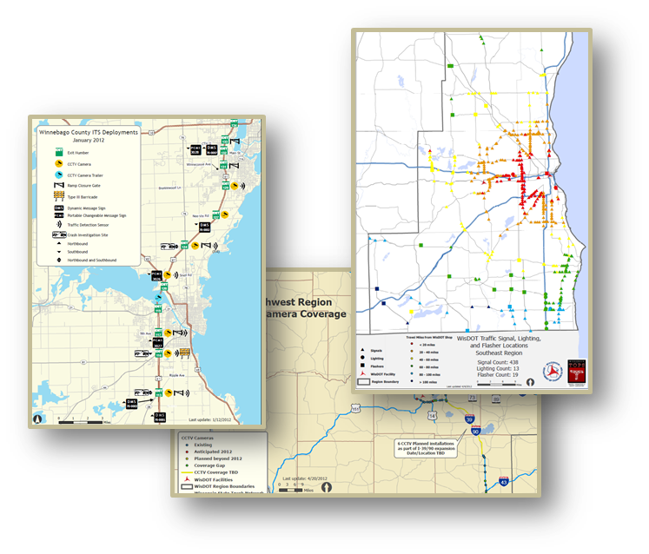
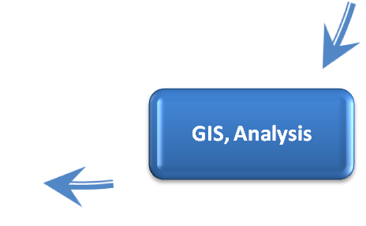
The ITS Process Cycle -
GIS
Visualizations, Mapping Products
Spatial Data
Spatial Information

Slide 5
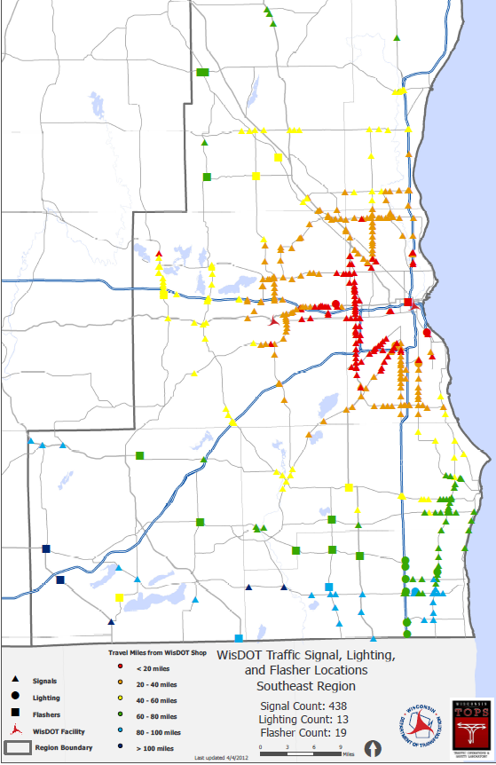
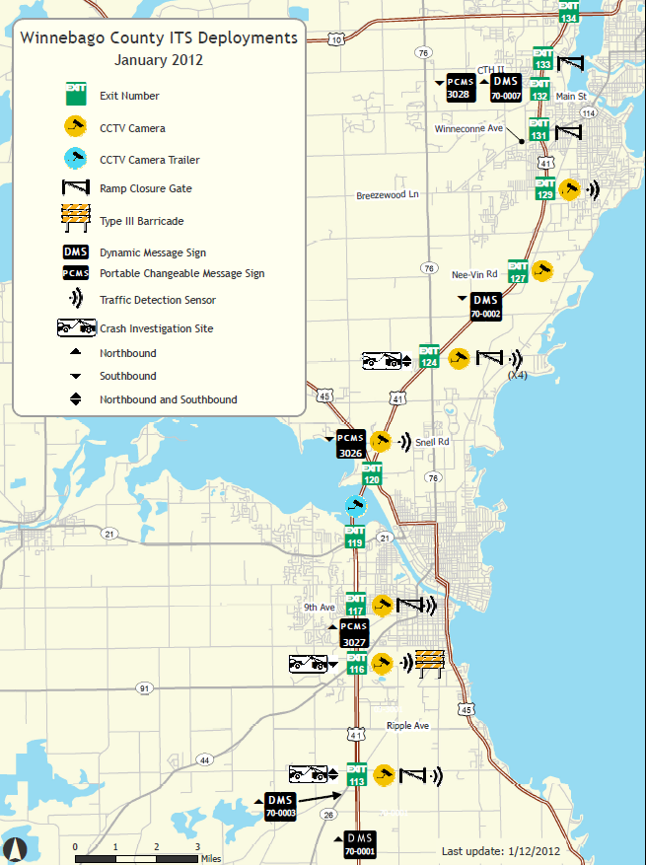
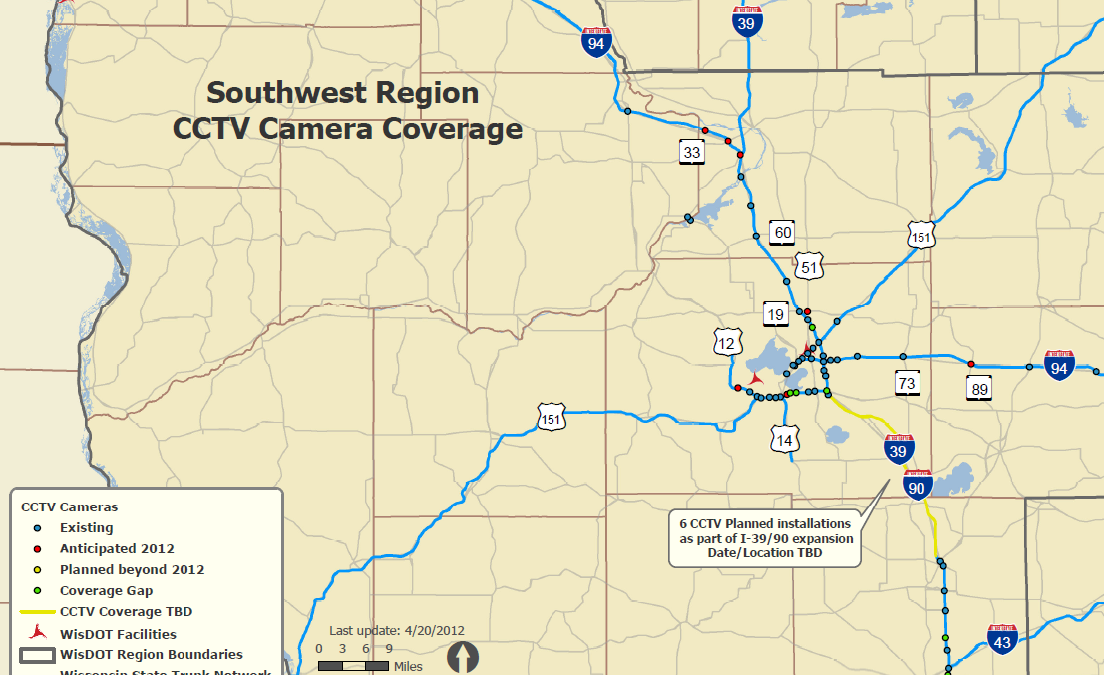

Slide 6
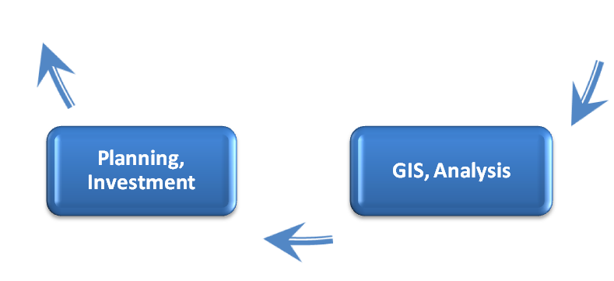
The ITS Process Cycle -
Planning Loop
Strategic Planning Loop
TOIP
ArcGIS

Slide 7
The ITS Process Cycle
Construction, Deployment
Spatial Inventory, Asset Management
GIS, Analysis
Planning, Investment
ITS Architecture
Systems Integration , Documentation
Systems Engineering, Design
Configuration
Management

